Slide 1


Goodcabs Operational Performance Dashboard – 2024
A data-driven view into trip patterns, passenger behavior, and city-level performance
by Animesh Daniel

Slide 2

Company Overview
Established Presence
Operating in 10 tier-2 cities across India
Empowering Drivers
Supporting local drivers through hometown service model
Passenger Focus
Committed to excellent passenger experience
2024 Goals
Ambitious performance targets to drive growth

Slide 3

Problem Statement
Need for Deeper Insights
Dashboard Requirement
Leadership wants visibility into key operational metrics
Chief of Operations needs passenger and city-level trends
Resource Constraints
Analytics team limited bandwidth limited

Slide 4
Dashboard Objective
Track Metrics
Compare Targets
Identify Trends
Analyze Temporal Patterns
Total trips, fare, distance, passenger type
Monthly targets at city level
Repeat vs new users, trip distribution
Weekday vs weekend performance
Enable data-driven decisions and service optimization aligned with 2024 goals

Slide 5
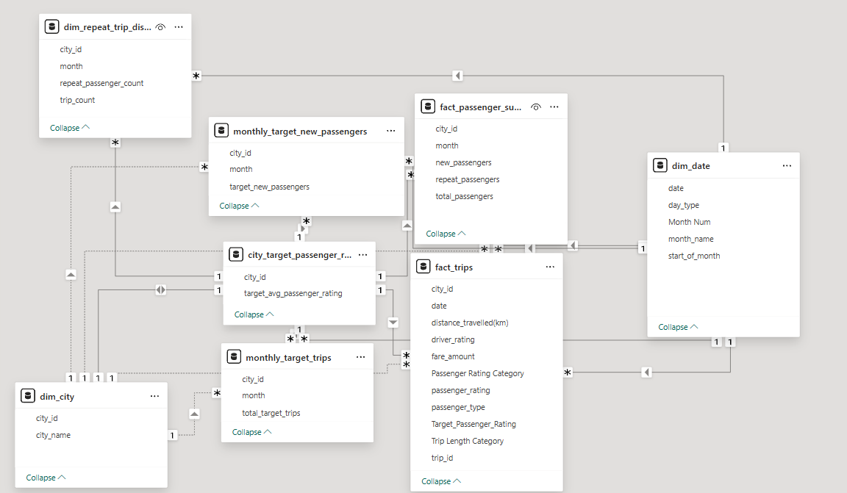
Data Model Overview

Slide 6
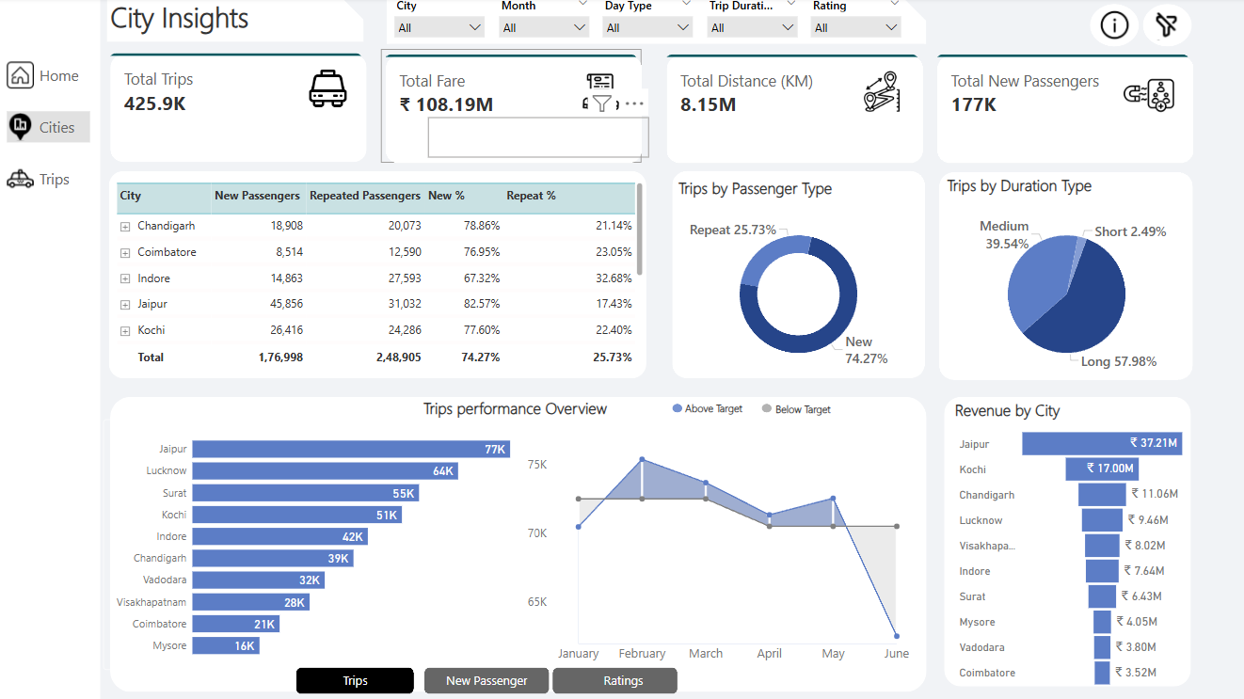
Power BI Dashboard Snapshots
City Insights

Slide 7
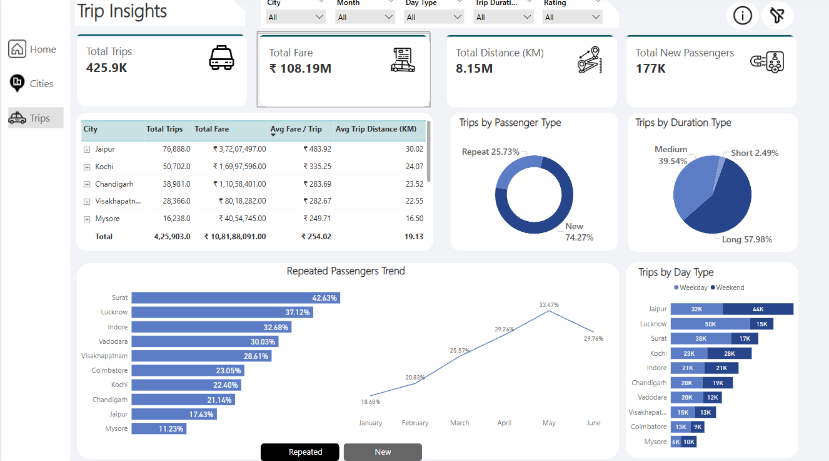
Power BI Dashboard Snapshots
Trip Insights

Slide 8
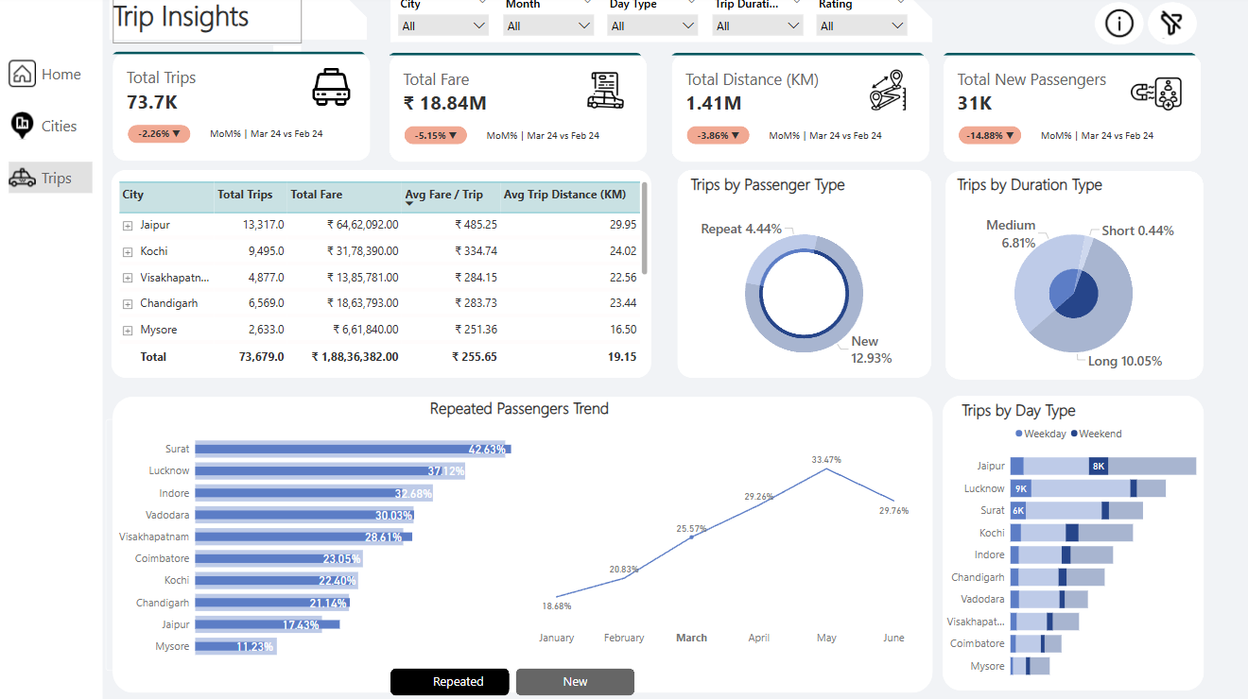
Power BI Dashboard Snapshots
Trip Insights

Slide 9

Recommendations & Key Insights
Operational Efficiency
Focus on cities with lower target achievement
New Passenger Acquisition
invest in targeted marketing and onboarding strategies to attract fresh users.
Peak Time Optimization
Optimize resources for weekday vs weekend demand shifts
Improve Low-Rated Driver Experiences
Conduct driver training and feedback programs to improve service quality.

Slide 10

Thank You
Contact & Connect: LinkedIn Profile

